Slide 1
Heart Attack Predictor
Elif Evrim Polat
Christopher Vasiliades
Paul Preetam

Slide 2
The Data & Machine Learning
Data source: Kaggle
Heart Attack Analysis & Prediction Dataset
Machine learning model used: Classification
Machine learning algorithms used:
Random Forest : 76%
Decision Tree: 69%
SVC: 75%
XGB: 72%

Slide 3
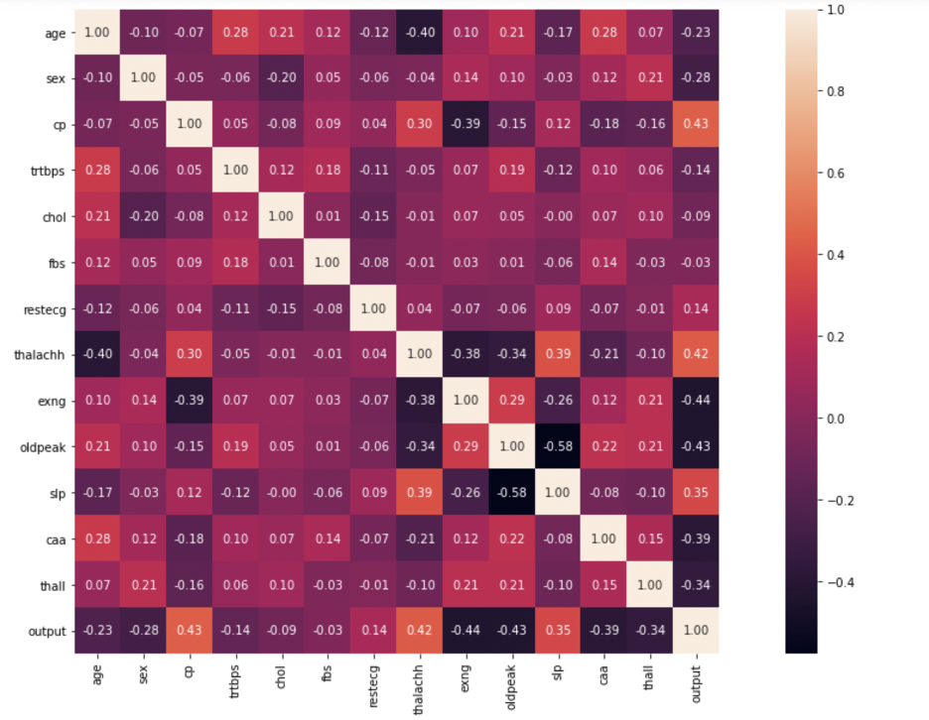

Slide 4
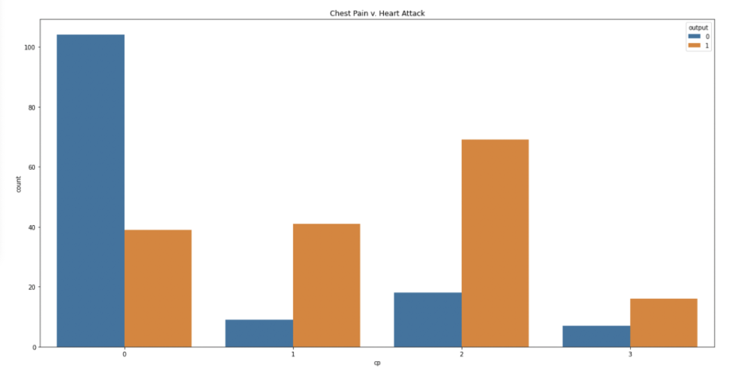

Slide 5
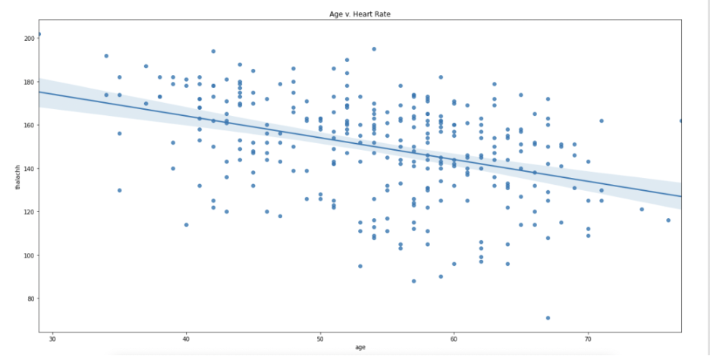

Slide 6
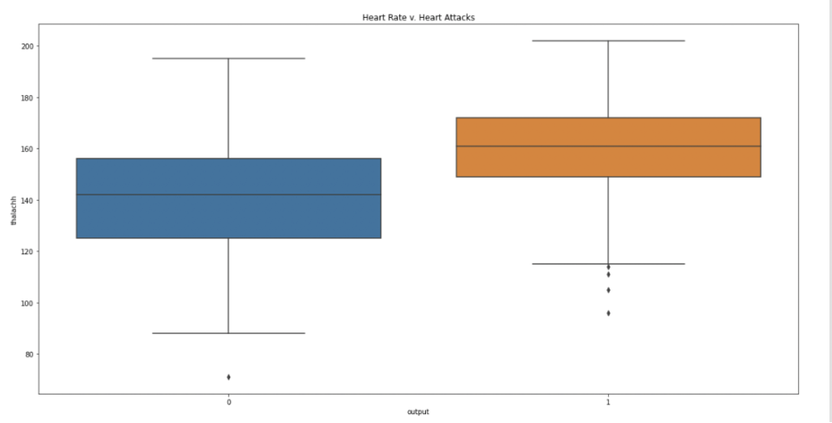

Slide 7
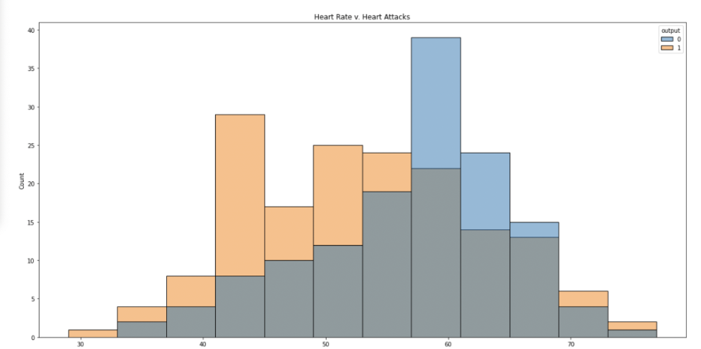

Slide 8
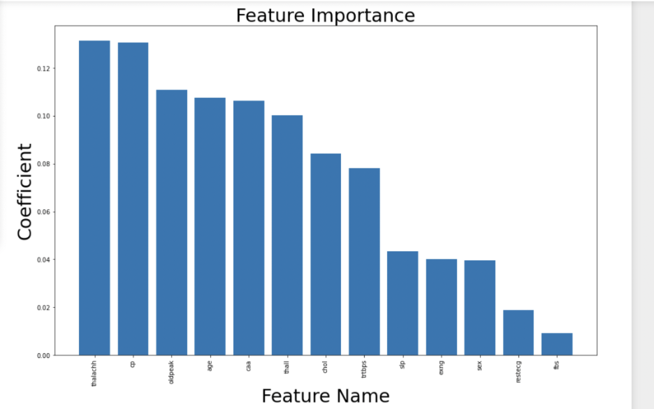

Slide 9
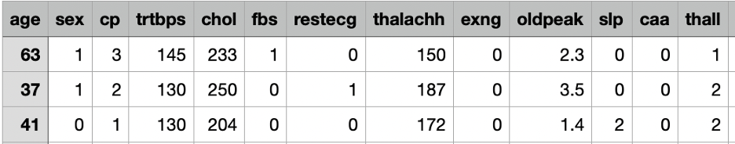
Dataset Description
Age : age of the patient
CP: chest pain type
Trtbps: resting blood pressure
Chol: Cholesterol
Thalachh: Maximum heart rate
Oldpeak: ST depression induced by exercise relative to rest
Caa: number of vessels
Thall: Inherited blood disorder

Slide 10
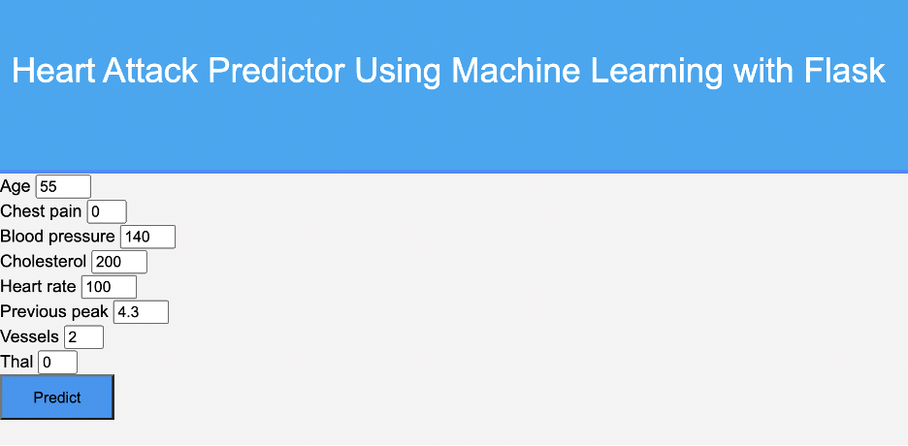
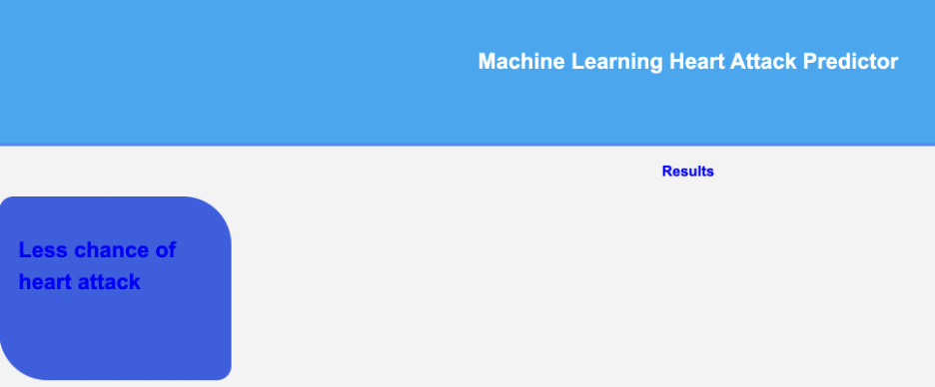
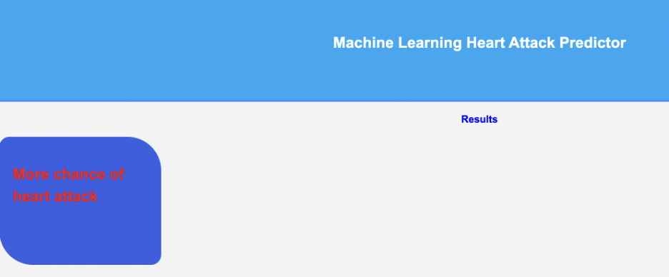

Slide 11
Demo

